Slide 1
.NET Solution
Building Blocks of the .NET Platform
(CLR, CTS and CLS)

Slide 2
The .NET Solution
What does .NET Framework (.NET) mean?
It is a software development framework from Microsoft.
It provides a controlled programming environment where software can be developed, installed and executed on Windows-based operating systems.
The .NET Framework is a new and innovative platform created by Microsoft for developing applications.
A programming infrastructure created by Microsoft for building, deploying, and running applications and services that use .NET technologies, such as desktop applications and Web services.
.NET framework is an integrated component of windows operating system that supports development and execution of next generation applications, Windows store apps and services.

Slide 3
The .NET Framework is designed to fulfill the following objectives
To provide a consistent object-oriented programming environment whether object code is stored and executed locally, executed locally but Internet-distributed, or executed remotely.
To provide a code-execution environment that minimizes software deployment and versioning conflicts.
To provide a code-execution environment that promotes safe execution of code, including code created by an unknown or semi-trusted third party.

Slide 4
Cont…
To provide a code-execution environment that eliminates the performance problems of scripted or interpreted environments.
To make the developer experience consistent across widely varying types of applications, such as Windows-based applications and Web-based applications.
To build all communication on industry standards to ensure that code based on the .NET Framework can integrate with any other code.

Slide 5
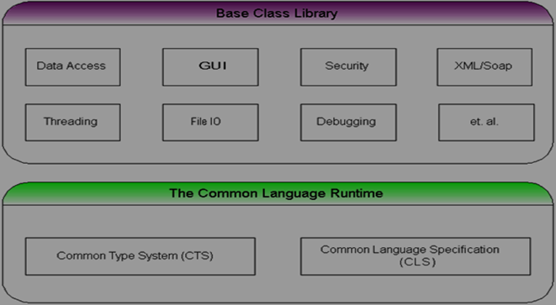
Introducing the Building Blocks of the .NET Platform (CLR, CTS, and CLS)
.Net framework is a technology or a programming infrastructure used for building and deployment of applications and services that use .NET technologies like XML web-based services or some .NET based desktop applications.

Slide 6
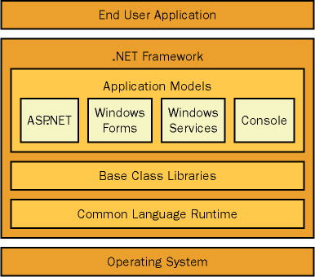

Slide 7
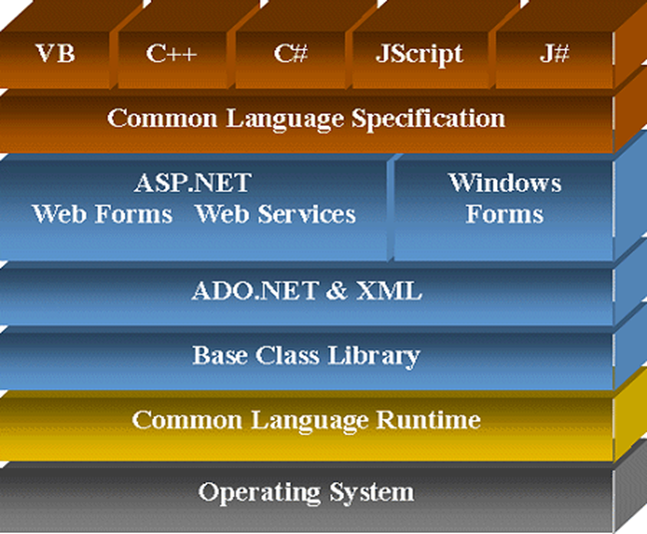

Slide 8
.NET Framework contains mainly two components
Common Language Runtime (CLR)
.NET Framework Class Library(FCL).
Common Language Runtime (CLR):
.NET Framework provides runtime environment called Common Language Runtime (CLR).
The CLR is the execution engine for .NET applications and serves as the interface between .NET applications and the operating system.
It provides an environment to run all the .NET Programs.
The code which runs under the CLR is called as Managed Code.
Programmers need not to worry on managing the memory if the programs are running under the CLR as it provides memory management and thread management.

Slide 9
Programmatically, when our program needs memory, CLR allocates the memory for scope and de-allocates the memory if the scope is completed.
Language Compilers will convert the Code/Program to Microsoft Intermediate Language (MSIL) intern this will be converted to Native Code by CLR.
Example of language compilers are: C#, VB.Net, J#
There are currently over 15 language compilers being built by Microsoft and other companies also producing the code that will execute under CLR.

Slide 10
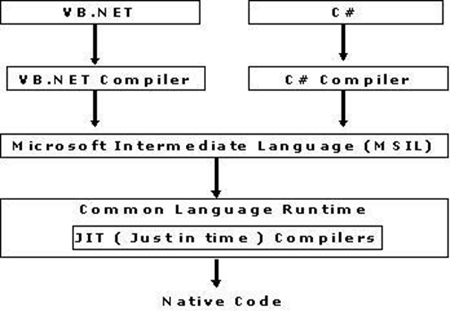

Slide 11
The main part of .NET Framework, which develops the base of the architecture, is the Common Language Runtime (CLR).
CLR acts as a bridge that is used to handles code at execution. It is the core part of .NET Framework and is responsible for memory management and thread management.
Runtime is the core of Microsoft's .NET vision. This is said to be the execution engine of .NET platform. The runtime (CLR) handles runtime services, including language integration, security, and memory management. During development, the runtime (CLR) provides features that are needed to simplify development.

Slide 12
.NET Framework Class Library (FCL)
The .NET Framework class library (FCL) provides the core functionality of .Net Framework architecture.
This is also called as Base Class Library and it is common for all types of applications.
This is a library of functionalities which are available to all languages using the .NET Framework.

Slide 13
It consists of classes, interfaces of reusable types that integrate with CLR.
The .Net Framework Class Library (FCL) includes a huge collection of reusable classes, interfaces, and value types that advance and optimize the development process and provide access to system functionality.
The .NET Framework class library is a library of classes, interfaces, and value types that provide access to system functionality.
It is the foundation on which .NET Framework applications, components, and controls are built.

Slide 14
The .Net framework class libraries are pre written classes and it’s available in all .NET programming languages and this list of pre written classes called as Namespaces.
The .Net Framework class library (FCL) organized in a hierarchical tree structure and it is divided into Namespaces.
Namespaces is a logical grouping of types for the purpose of identification.

Slide 16
Framework class library (FCL) provides the consistent base types that are used across all .NET enabled languages.
The Classes are accessed by namespaces, which reside within Assemblies.
The System Namespace is the root for types in the .NET Framework.
The .Net Framework class library (FCL) classes are managed classes that provide access to System Services.

Slide 17
Core Features of .Net
Interoperability: This allows for .NET-developed programs to access functionalities in programs developed outside .NET.
Common Runtime Engine: Also known as the common language runtime, this allows programs developed in .NET to exhibit common behaviors in memory usage, exception handling and security.
Language Independence: Common language infrastructure specifications (CLI) allow for the exchange of data types between two programs developed in different languages.

Slide 18
Base Class Library: A library of code for most common functions--used by programmers to avoid repetitive rewriting of code.
Ease of Deployment: There are tools to ensure the ease of installing programs without interfering with previously installed applications.
Security: Programs developed in .NET are based on a common security model.

Slide 19
Which versions of .NET are available?
.NET Framework 1.0
.NET Framework 1.1 (comes installed in Windows Server 2003)
.NET Framework 2.0 (comes installed in Windows Server 2003, 2003 R2, 2008 SP2 and 2008 R2 SP1)
.NET Framework 3.0 (comes installed in Windows Vista and Server 2008 SP2 and 2008 R2 SP1)
.NET Framework 3.5 (comes installed in Windows 7 and Server 2008 R2 SP1)
.NET Framework 4.0
.NET Framework 4.5 (comes installed in Windows 8 and Server 2012)
.NET Framework 4.5.1 (comes installed in Windows 8.1 and Server 2012 R2)
.NET Framework 4.5.2
.NET Framework 4.6 (comes installed in Windows 10 and Server 2016)

Slide 20
Type of .NET Languages
The .NET Framework was developed so that it could support a theoretically infinite number of development languages. Currently, more than 20 development languages work with the .NET Framework.
VC++
VB.NET
C#
J#
JScript .NET

Slide 21
Why should I install .NET on my computer?
Because many new software applications require .NET.
Having the latest version already installed on your computer enables you run new .NET applications immediately as they become available.

Slide 22
How do know if I already have .NET?
Click Start on your Windows desktop.
Select Control Panel.
Double-click Add or Remove Programs.
When the Add/Remove window appears, scroll through the list of applications and try to find Microsoft .NET Framework. There you will see which versions of .NET are installed on your PC.

Slide 23
What C# brings to the table (introduction to C#)
C# - pronounced "C sharp“.
it is a simple, modern, object-oriented, and type-safe programming language.
It will immediately be familiar to C and C++ programmers.
C# combines the high productivity of Rapid Application Development (RAD) languages and the raw power of C++.

Slide 24
C# is a simple, modern, general-purpose, object-oriented programming language developed by Microsoft within its .NET initiative led by Anders Hejlsberg.
C# developed by Microsoft and approved by European Computer Manufacturers Association (ECMA) and International Standards Organization (ISO).

Slide 25
C# is designed for Common Language Infrastructure (CLI).
which consists of the executable code and runtime environment that allows use of various high-level languages on different computer platforms and architectures.

Slide 26
Reasons make C# a widely used professional language
It is a modern, general-purpose programming language
It is object oriented.
It is component oriented.
It is easy to learn.
It is a structured language.
It produces efficient programs.
It can be compiled on a variety of computer platforms.
It is a part of .Net Framework.

Slide 27
MAIN FEATURES OF C#
SIMPLE
Pointers are missing in C#.
Unsafe operations such as direct memory manipulation are not allowed.
In C# there is no usage of "::" or "->" operators.
Since it's on .NET, it inherits the features of automatic memory management and garbage collection.
Varying ranges of the primitive types like Integer, Floats etc.
Integer values of 0 and 1 are no longer accepted as boolean values. Boolean values are pure true or false values in C# so no more errors of "="operator and "=="operator.
"==" is used for comparison operation and "=" is used for assignment operation.

Slide 28
MODERN:
C# has been based according to the current trend and is very powerful and simple for building interoperable, scable, robust applications.
C# includes built in support to turn any component into a web service that can be invoked over the internet from any application running on any platform.
OBJECT ORIENTED:
C# supports Data Encapsulation, inheritance, polymorphism, interfaces.
(int,float, double) are not objects in java but C# has introduces structures(structs) which enable the primitive types to become objects.

Slide 29
TYPE SAFE
In C# we cannot perform unsafe casts like convert double to a boolean.
Value types (primitive types) are initialized to zeros and reference types (objects and classes) are initialized to null by the compiler automatically.
arrays are zero base indexed and are bound checked.
Overflow of types can be checked.
INTEROPERABILITY
C# includes native support for the COM and windows based applications.
Allowing restricted use of native pointers.
Users no longer have to explicitly implement the unknown and other COM interfaces, those features are built in.
C# allows the users to use pointers as unsafe code blocks to manipulate your old code.
Components from VB NET and other managed code languages and directly be used in C#.

Slide 30
SCALABLE AND UPDATEABLE
.NET has introduced assemblies which are self describing by means of their manifest. manifest establishes the assembly identity, version, culture and digital signature etc. Assemblies need not to be register anywhere.
To scale our application we delete the old files and updating them with new ones. No registering of dynamic linking library.
Updating software components is an error prone task. Revisions made to the code. can effect the existing program C# support versioning in the language. Native support for interfaces and method overriding enable complex frame works to be developed and evolved over time.

Slide 31
Additional .Net aware programming Language
C# is not the only language targeting the .NET platform.
The .NET platform was first discovered to the general public during the 2000 Microsoft Professional Developers Conference (PDC), several vendors announced they were busy building .NET-aware versions of their respective compilers.
It means the dozens of different languages have undergone .NET explanation.
The five languages that ship with Visual Studio 2005 (C#, J#, Visual Basic .NET, Managed Extensions for C++, and JScript .NET).

Slide 33
A number of .NET-enabled programming languages and where to learn more about them

Slide 34
An overview of .Net Assemblies
Building blocks of .NET Framework applications.
It is a logical unit of code or (A chunk of (precompiled) code that can be executed by the .NET runtime environment.)
Assembly contains code which the Common Language Runtime (CLR) executes.
It is a fundamental unit of deployment, version control, reuse, activation scoping, and security permissions.

Slide 35
Assembly is a collection of types and resource information that are built to work together and form a logical unit of functionality.
During the compile time Metadata is created with Microsoft Intermediate Language (MSIL) this file is called as Assembly.
Assembly contains two files they are: exe and dll.
Exe – executable.
Dll – dynamic link library.

Slide 36
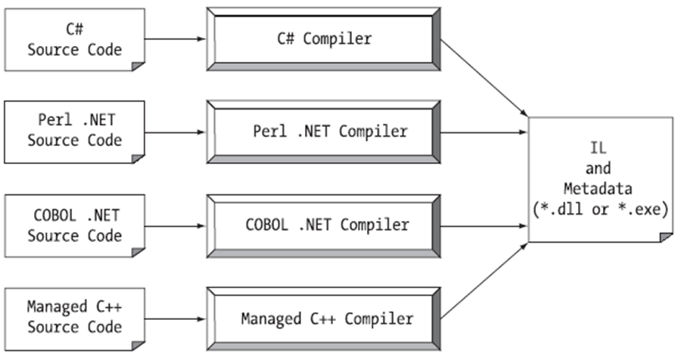

Slide 37
Assemblies include both executable application files that you can run directly from Windows without the need for any other programs.
Assembly is a compiled output of program which are used for easy deployment of an application.
A .NET program consists of one or more assemblies.

Slide 38
Metadata
Metadata in .Net is binary information which describes the characteristics of a resource.
This information include Description of the Assembly , Data Types and members with their declarations and implementations, references to other types and members , Security permissions etc.
A module's metadata contains everything that needed to interact with another module.

Slide 39
MSIL (Microsoft Intermediate Language) Code
MSIL stands for Microsoft Intermediate Language.
We can call it as Intermediate Language (IL) or Common Intermediate Language (CIL).
When we compile our .Net Program using any .Net compliant language like (C#, VB.NET, C++.NET).
It does not get converted into the executable binary code but to an intermediate code, called MSIL or IL in short, understandable by CLR.
MSIL is an OS and H/w independent code.
When the program needs to be executed, this MSIL or intermediate code is converted to binary executable code, called native code.

Slide 40
Microsoft Intermediate Language (MSIL) is a CPU-independent set of instructions that can be efficiently converted to the native code.
During the runtime the Common Language Runtime (CLR)'s Just In Time (JIT) compiler converts the Microsoft Intermediate Language (MSIL) code into native code to the Operating System.

Slide 41
When a compiler produces Microsoft Intermediate Language (MSIL), it also produces Metadata.
The Microsoft Intermediate Language (MSIL) and Metadata are contained in a portable executable (PE) file .
Microsoft Intermediate Language (MSIL) includes instructions for loading, storing, initializing, and calling methods on objects, as well as instructions for arithmetic and logical operations, control flow, direct memory access, exception handling, and other operations.

Slide 42
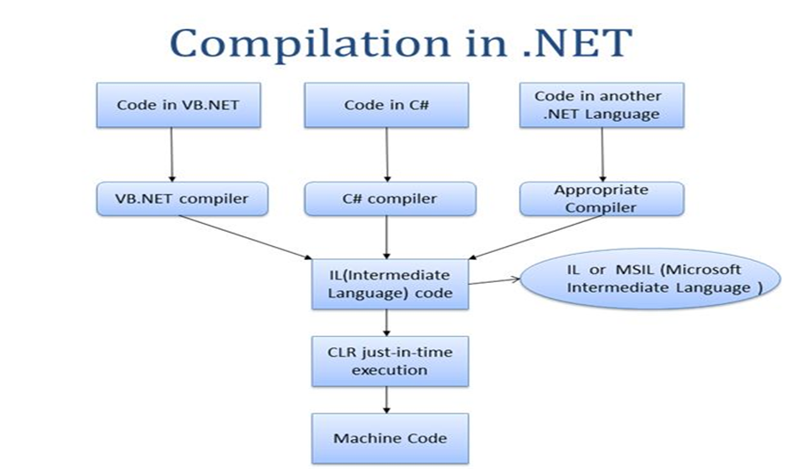

Slide 43
Two kinds (types) of assemblies in .NET
A private Assembly is used only by a single application, and usually it is stored in that application's install directory (The dll or exe which is sole property of one application only. It is generally stored in application root folder).
A shared Assembly is one that can be referenced by more than one application.
If multiple applications need to access an Assembly, we should add the Assembly to the Global Assembly Cache (GAC).
(GAC is simply C:\Windows\Assembly folder where you can find the public assemblies/dlls of all the software’s installed in your PC.)
Third and last known type of an assembly: Satellite Assembly . A Satellite Assembly contains only static objects like images and other non-executable files required by the application.

Slide 44
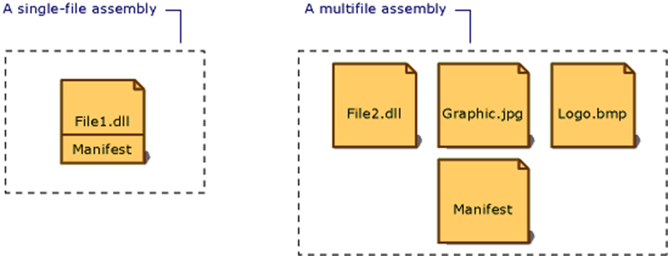
Single-file assembly & Multifile assembly
When the component of an assembly is grouped (collected) in a single physical file, it is known as Single-file assembly.
When the component of an assembly is contained in several files, it is known as Multifile assembly.
These files can be modules of compiled code (.netmodule), resources (such as .bmp or .jpg files), or other files required by the application.

Slide 45
A .NET assembly contain the following elements
Assembly Manifest – Metadata that describes the assembly and its contents.
Source Code – Compiled into Microsoft intermediate language (MSIL)
Type Metadata – Defines all types, their properties and methods.
Resources – Icons, images, text strings and other resources
The assembly manifest is required; the other elements are optional.

Slide 46
What is an assembly manifest?
An assembly manifest is a text file containing metadata about assemblies.
It describes the relationship and dependencies of the components in the assembly, versioning information, scope information and the security permissions required by the assembly.
Assembly Manifest contains a collection of data that describes how the elements in the assembly relate to each other.

Slide 47
The manifest contains:
Strong Name – The assembly’s name, version, culture, optional processor architecture, and public key (for shared assemblies)
File Contents – Name and hash of all files in the assembly
Type List – Types defined in the assembly, including public types that are exported from the assembly
Resource List – Icons, images, text strings and other resources contained in the assembly
Dependencies – Compile-time dependencies on other assemblies
Security – Permissions required for the assembly to run properly

Slide 48
Common Type System (CTS)
The language interoperability, and .NET Class Framework, are not possible without all the language sharing the same data types.
The Common Type System (CTS) is a standard for defining and using data types in the .NET framework.
CTS define a collection of data types, which are used and managed by the run time to make easy of cross-language integration.

Slide 49
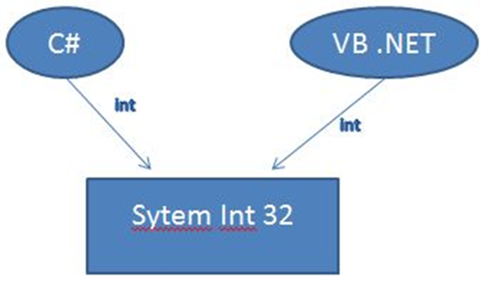
How CTS works?
CTS is converting the data type to a common data type.
when we declare an int type data type in C# and VB.Net then they are converted to int32.
In other words, now both will have a common data type that provides flexible communication between these two languages.

Slide 50
common type system performs the following functions
Establishes a framework that helps enable cross-language integration, type safety, and high-performance code execution.
Provides an object-oriented model that supports the complete implementation of many programming languages.
Defines rules that languages must follow, which helps ensure that objects written in different languages can interact with each other.
Provides a library that contains the primitive data types (such as Boolean, Byte, Char, Int32, and UInt64) used in application development.

Slide 51
common type system supports two general categories of types
Value types
Value types directly contain their data, and instances of value types are either allocated on the stack or allocated inline in a structure. Value types can be built-in, user-defined or enumerations types.
Reference types
Reference types stores a reference to the value's memory address, and are allocated on the heap. Reference types can be self-describing types, pointers types, or interface types.

Slide 52
The common type system in the .NET Framework supports the following five categories of types
Classes
Structures
Enumerations
Interfaces
Delegates

Slide 53
CTS Class Types
A class is a reference type that can be derived directly from another class and that is derived implicitly from System::Object.
The class defines the operations that an object (which is an instance of the class) can perform (methods, events, or properties) and the data that the object contains (fields).

Slide 54
CTS Structures Types
A structure is a value type that derives implicitly from System::ValueType, which in turn is derived from System::Object.
A structure is very useful for representing values whose memory requirements are small, and for passing values as by-value parameters to methods that have strongly typed parameters.
In the .NET Framework class library, all primitive data types (Boolean, Byte, Char, DateTime, Decimal, Double, Int16, Int32, Int64, SByte, Single, UInt16, UInt32, and UInt64) are defined as structures.

Slide 55
CTS Enumerations Types
An enumeration (enum) is a value type that inherits directly from System::Enum and that supplies alternate names for the values of an underlying primitive type.
An enumeration type has a name, an underlying type that must be one of the built-in signed or unsigned integer types (such as Byte, Int32, or UInt64), and a set of fields.
The fields are static literal fields, each of which represents a constant.
The same value can be assigned to multiple fields.

Slide 56
CTS Interfaces Types
An interface defines a contract that specifies a "can do" relationship or a "has a" relationship.
Interfaces are often used to implement functionality, such as comparing and sorting (the IComparable and IComparable<T> interfaces), testing for equality (the IEquatable<T> interface), or enumerating items in a collection (the IEnumerable and IEnumerable<T> interfaces)

Slide 57
Interfaces can have properties, methods, and events, all of which are abstract members;

Slide 58
CTS Delegates Types
Delegates are reference types that serve a purpose similar to that of function pointers in C++.
They are used for event handlers and callback functions in the .NET Framework.
Unlike function pointers, delegates are secure, verifiable, and type safe.
A delegate type can represent any instance method or static method that has a compatible signature.

Slide 59
Common Language Specification (CLS)
CLS - Common Language Specification.
it is a subset (compartment) of CTS.
It defines a set of rules and restrictions that every language must follow which runs under .NET framework.
The languages which follows these set of rules are said to be CLS Compliant. In simple words, CLS enables cross-language integration.
For example, one rule is that you cannot use multiple inheritance within .NET Framework. As you know C++ supports multiple inheritance but; when you will try to use that C++ code within C#, it is not possible because C# doesn’t supports multiple inheritance.

Slide 60
One another rule is that you cannot have members with same name with case difference only.
i.e. you cannot have add() and Add() methods.
This easily works in C# because it is case-sensitive.
when you will try to use that C# code in VB.NET, it is not possible because VB.NET is not case-sensitive.

Slide 61
Common Language Runtime (CLR)
CLR - Common Language Runtime.
It is a heart of Dot Net Framework.
It is a core runtime environment of .NET Framework for executing applications.
The main function of Common Language Runtime (CLR) is to convert the Managed Code into native code and then execute the Program.

Slide 62
It acts as a layer between Operating Systems and the applications written in .Net languages.
CLR handles the execution of code and provides useful services for the implementation of the program.
In addition to executing code, CLR provides services such as memory management, thread management, security management, code verification, compilation, and other system services.

Slide 63
Why Is the CLR Important?
In many traditional execution environments of the past, programmers needed to perform a lot of the low-level work (plumbing) that applications needed to support.
For example, you had to build custom security systems, implement error handling, and manage memory.

Slide 64
These services (custom security systems, implement error handling, and manage memory)were supported on different language platforms varied considerably.
Visual Basic (VB) programmers had built-in memory management and an error-handling system, but they didn't always have easy access to all the features of COM+, which opened up more sophisticated security and transaction processing.

Slide 65
C++ programmers have full access to COM+ and exception handling, but memory management is a totally manual process.
you learn about how .NET supports multiple languages,
The CLR solves many problems of the past by offering a feature-rich set of plumbing services that all languages can use.

Slide 66
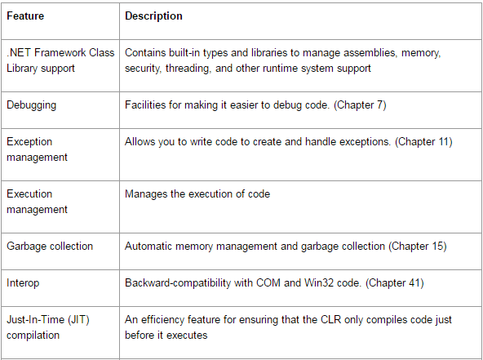
CLR Features

Slide 67
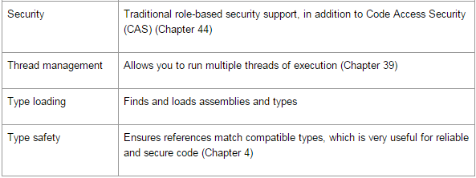

Slide 68
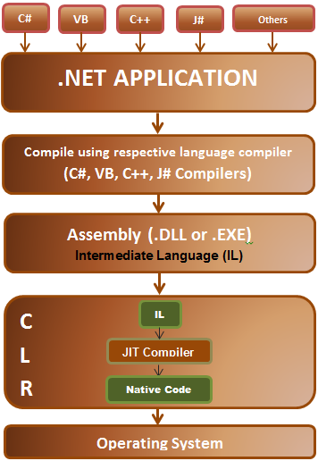
The CLR Execution Process

Slide 69
Choosing the right compiler:
.NET Framework is a Multilanguage execution environment.
The runtime supports a wide variety of data types and language features.
In order to obtain the full benefits provided by the common language runtime , you should use one or more language (VB.Net, C# etc.) compilers that target the runtime

Slide 70
Compiling the code to MSIL:
The execution style of compiling source code into machine level code, .Net language compilers translates the source code into Microsoft Intermediate Language.
This ensures language interoperability because no matter which language has been used to develop the application, it always gets translated to Microsoft Intermediate Language.
During the compile time the compiler produces metadata, that contains description of the program like dependencies, versions etc

Slide 71
Compiling MSIL to native code:
Before the program execution , Just In Time compiler (JIT) compiles the MSIL into native code and stores it in a memory buffer.
During JIT compilation, the code is also checked for type safety.
Type safety ensures that objects are always accessed in a compatible way.
The compiled native code is in memory and is not persisted.
So every time we run our application this whole thing has to happen again.

Slide 72
Execution of Code:
After translating the IL into native code, it is sent to .Net runtime manager.
The .Net runtime manager executes the code.
During execution, managed code receives services such as garbage collection, security, interoperability with unmanaged code, cross-language debugging support, and enhanced deployment and versioning support.

Slide 73
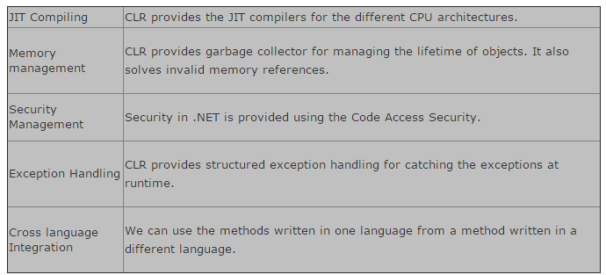
Services provided by the CLR

Slide 74
Building C# Applications
C# may choose to build .NET applications.

Slide 75
Installing the .NET Framework SDK
Before you are able to build .NET applications using the C# programming language and the .NET Framework, the first step is to install.
It is freely downloadable .NET Framework Software Development Kit (SDK).
The .NET Framework SDK is automatically installed with Visual Studio 2005 as well as Visual C# 2005 Express.
If you plan to use either of these IDEs, there is no need to manually download or install this software package.

Slide 76
If you are not developing with Visual Studio 2005/Visual C# 2005 Express.
find the way to: http://msdn.microsoft.com/netframework and search for “.NET Framework SDK”.
Once you have located the appropriate page, download setup.exe and save it to a location on your hard drive.
At this point, double-click the executable to install the software.

Slide 77
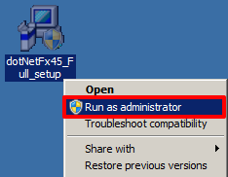

Slide 78
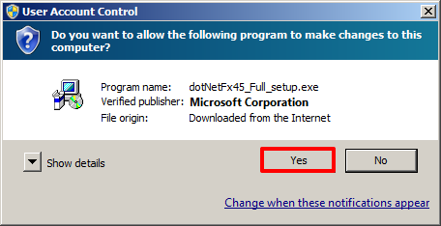
2. If prompted, click Yes to allow the program to make changes to the computer.

Slide 79
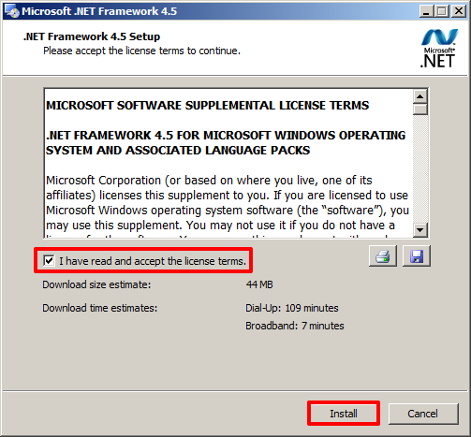
When prompted, in the ‘.Net Framework 4.5 Setup’ window, check the box to accept the license terms and click Install.

Slide 80
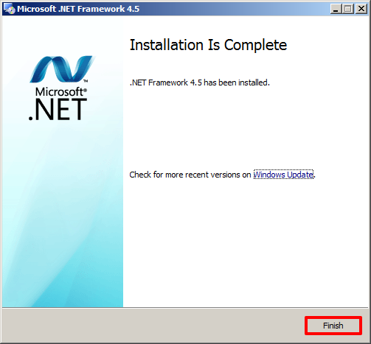
Once the installation has completed, click Finish

Slide 81
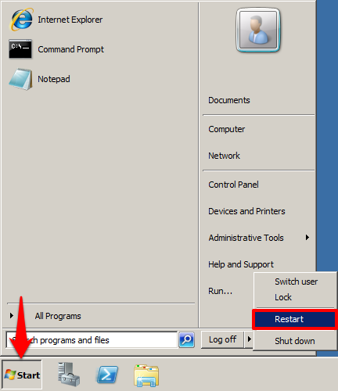
Perform a manual restart of your Computer

Slide 82
Without integrated development environment (IDE)
Step 1: Open Notepad and write the c# code carefully.
Step 2: Now save this program as Chapter1.cs in csharp Folder in D drive (Create csharp Folder in D Drive). You must choose All Files in save as type box.

Slide 83
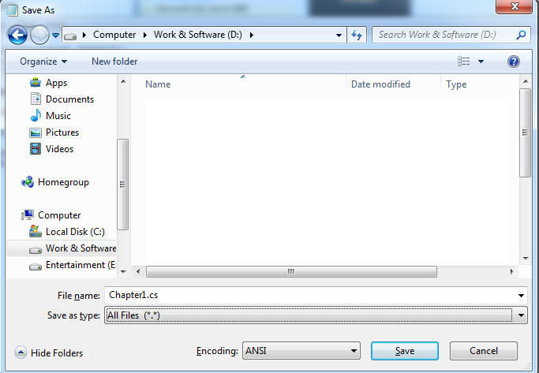

Slide 84
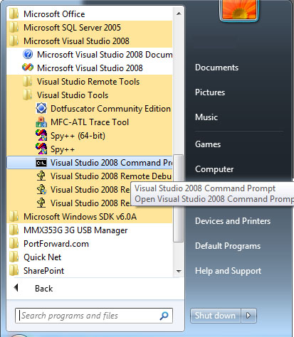
Step 3: Go to Start > All Programs > Microsoft Visual Studio 2005 or 2008 > Visual Studio Tools > Visual Studio 2005 or 2008 Command Prompt.

Slide 85
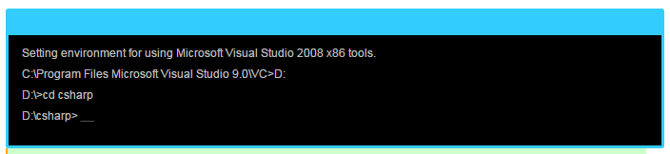
Step 4: Set Path in command prompt where your Chapter1.cs file is saved. Here we are using D:/csharp.
Type D: and hit Enter
Now type cd csharp and hit Enter
You are in Csharp Folder now.

Slide 86
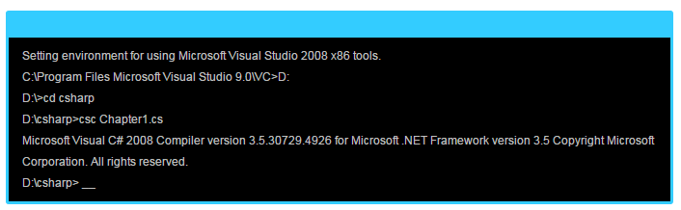
Step 5: Now compile your program by following command

Slide 87
You will see some information like compiler version number and framework information.
There is no error, so you won’t get any error.

Slide 88
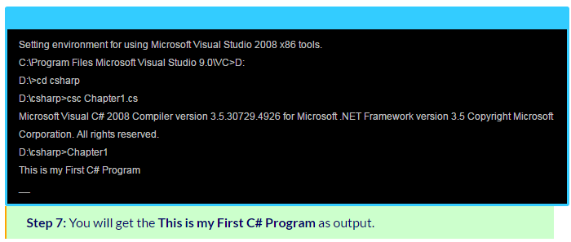
Step 6: Now, it’s turn to C sharp program. Just write your file name without extension and hit enter.

Slide 89
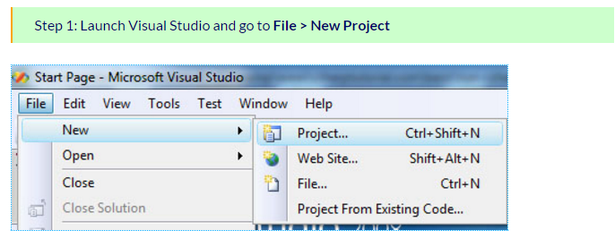
Using Visual Studio 2005/2008/2012 or any version
Visual Studio is easiest way to handle C# code. To execute the program on visual studio.

Slide 90
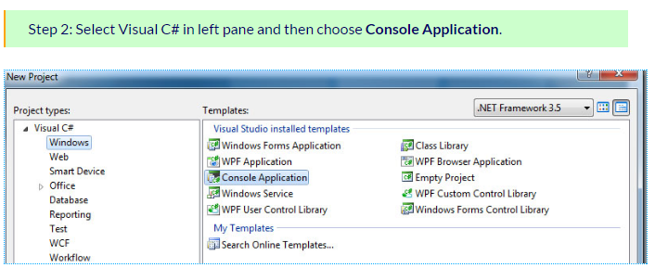

Slide 91
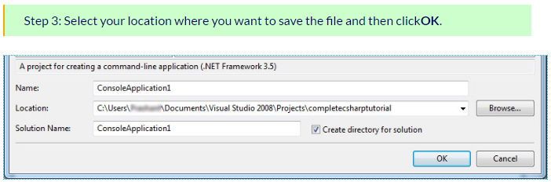

Slide 92
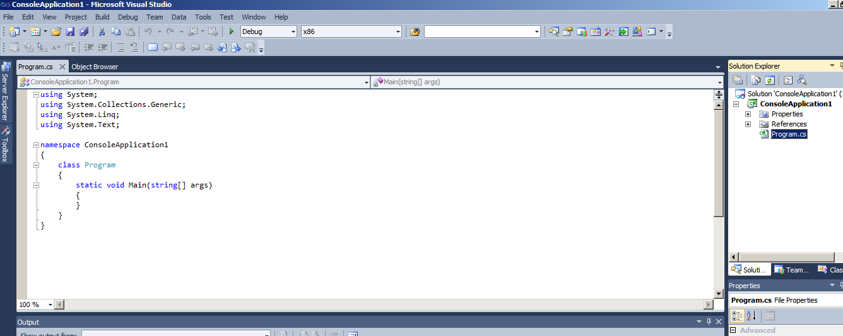

Slide 93
C# Command Line Compiler(CSC.exe)
There are a number of techniques may use to compile C# source code.
In addition to Visual Studio 2005 (as well as various third-party .NET IDEs), you are able to create .NET assemblies using the C# command-line compiler, csc.exe (csc stands for C-Sharp Compiler).
This tool is included with the .NET Framework 2.0 SDK. While it is true that you may never decide to build a large-scale application using the command-line compiler, it is important to understand the basics of how to compile your *.cs files by hand.

Slide 94
What is CSC.EXE ?
Command Line Compiler takes C# code as input and transforms code to MSIL/CIL.
(Microsoft intermediate language/Common intermediate language).
CSC.exe produces .dll (dynamic link library) and .exe (executable) files.

Slide 95
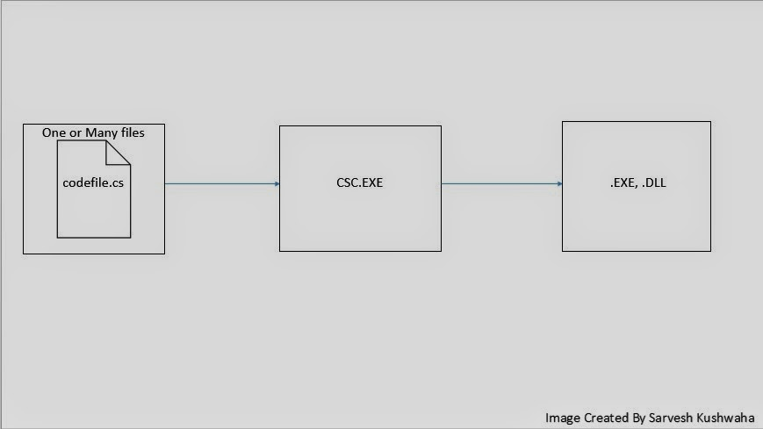

Slide 96
CSC.exe comes with .net framework.
you can install it standalone too. which is in :
c:\Windows\Microsoft.Net\Framework\v4.0.30319{version installed on your computer}\csc.exe

Slide 97
Configuring the C# Command-Line Compiler
Before you can begin to make use of the C# Command Line Compiler, you need to ensure that your development machine recognizes the existence of csc.exe.
If your machine is not configured correctly, you are forced to specify the full path to the directory containing csc.exe before you can compile your C# files.

Slide 98
Right-click the My Computer icon and select Properties from the pop-up menu.
Select the Advanced tab and click the Environment Variables button.
Double-click the Path variable from the System Variables list box.
Add the following line to the end of the current Path value (note each value in the Path variable is separated by a semicolon): C:\Windows\Microsoft.NET\Framework\v2.0.50215

Slide 99
Configuring Additional .NET Command-Line Tools
Before you begin to examine csc.exe, add the following additional Path variable to the System Variables list box :
C:\Program Files\Microsoft Visual Studio 8\SDK\v2.0\Bin
Recall that this directory contains additional command-line tools that are commonly used during .NET development.
These two paths established, you should now be able to run any .NET utility from any command window.

Slide 100
Building C# Applications Using csc.exe
Once your development machine recognizes csc.exe, The next goal is to build a C# simple Application using the C# command-line compiler and Notepad.
First, Need some source code.
Open Notepad and enter the source code.

Slide 101
// A simple C# application.
using System;
class TestApp
{
public static void Main()
{
Console.WriteLine("Testing! 1, 2, 3");
}
}

Slide 102
After Typing program, save the file in a convenient location (e.g., C:\CscExample) as TestApp.cs.
Now, let’s get to know the core options of the C# compiler.
The first point of interest is to understand how to specify the name and type of assembly to create.
Example: myShell.exe and Mathlib.dll etc.

Slide 103
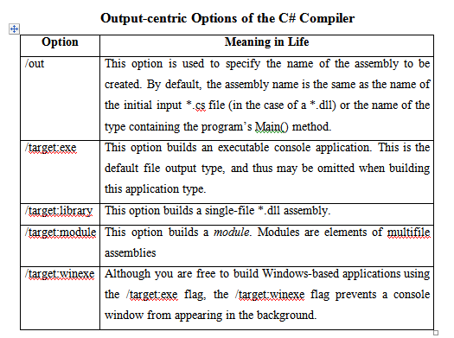
Each possibility is represented by a specific flag passed into csc.exe as a command-line parameter

Slide 104
To compile TestApp.cs into a console application named TestApp.exe,
change to the directory containing your source code file and enter the following command set (note that command-line flags must come before the name of the input files, not after):
csc /target:exe TestApp.cs

Slide 105
Here, did not explicitly specify an /out flag, therefore the executable will be named TestApp.exe, given that TestApp is the class defining the program’s entry point.
Also be aware that most of the C# compiler flags support an abbreviated version, such as /t rather than /target (you can view all abbreviations by entering csc /? at the command prompt):
csc /t:exe TestApp.cs
Furthermore, given that the /t:exe flag is the default output used by the C# compiler, you could also compile TestApp.cs simply by typing
csc TestApp.cs

Slide 106
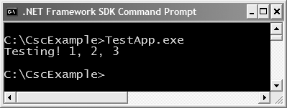
TestApp.exe can now be run from the command line

Slide 107
Referencing External Assemblies
First learn mscorlib.dll.
Microsoft Common Object Runtime Library.
It is the shared dll or Assembly.
It is the most basic dll which consists of the most basic Base class libraries.
Mscorlib.dll is a module associated with .NET Compact Framework from Microsoft Corporation

Slide 108
The mscorlib.dll resides in: c:/windows/Microsoft.NET/Framework/mscorlib.dll.
The mscorlib.dll file is the pre-coded solutions that form the framework's Base Class Library.
The mscorlib.dll program file included in the BCL encapsulates a large number of common functions, such as:
file reading and writing, graphic representation, database interaction, and XML document manipulation.

Slide 109
The library is available to all languages using the .NET Framework in order to make the programmer's job easier.
The DLL mscorlib.dll is used by programmers who combine it with their own code to produce applications.
MSCorlib.dll is the heart of .NET framework which contains all the type definition and most of the commonly used functionality.

Slide 110
MSCorlib.dll is tightly bound to CLR. MSCorlib.dll is loaded and bound in every .NET application.
Mscorlib is the assembly that contains the core implementation of the .NET framework.
Mscorlib.dll is holding some fundamental classes of .net such as system.

Slide 111
Examine how to compile an application that makes use of types defined in a separate .NET assembly.
You are questioning how the C# compiler understood your reference to the System.Console type,.
mscorlib.dll is automatically referenced during the compilation process.

Slide 112
The process of referencing external assemblies.
The TestApp application to display a Windows Forms message box:
using System;
// Add this!
using System.Windows.Forms;
class TestApp
{
public static void Main()
{
Console.WriteLine("Testing! 1, 2, 3");
// Add this!
MessageBox.Show("Hello...");
} }

Slide 113
The reference to the System.Windows.Forms namespace via the C# using keyword.
when you explicitly list the namespaces used within a given *.cs file, you avoid the need to make use of fully qualified names.
At the command line, you must inform csc.exe which assembly contains the “used” namespaces.
Use of the Message Box class, you must specify the System.Windows.Forms.dll assembly using the /reference flag (/reference can be abbreviated to /r):
csc /r:System.Windows.Forms.dll testapp.cs

Slide 114
Compiling Multiple Source Files with csc.exe
The current life of the TestApp.exe application was created using a single *.cs source code file.
While it is perfectly permissible to have all of your .NET types defined in a single *.cs file, most projects are composed of multiple *.cs files to keep your code base a bit more flexible.

Slide 115
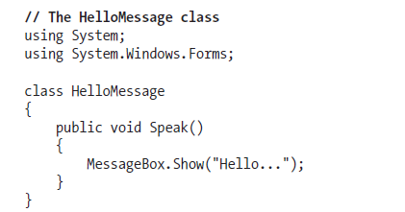
Assume you have authored an additional class contained in a new file named HelloMsg.cs:

Slide 116
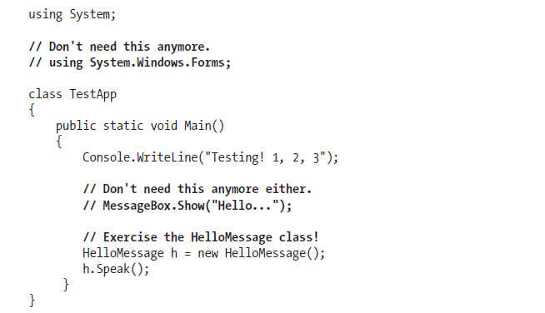
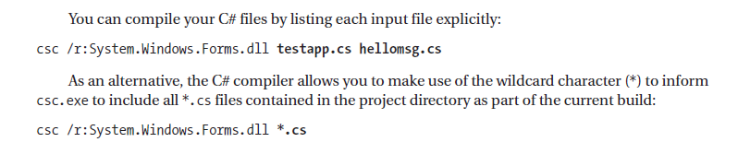
update TestApp class to make use of this new type

Slide 117
When you run the program again, the output is identical.
The only difference between the two applications is the fact that the current logic has been split among multiple files.
Referencing Multiple External Assemblies
if you need to reference numerous external assemblies using csc.exe.
Simply list each assembly using a semicolon-delimited list. You don’t need to specify multiple external assemblies for the current example, but some sample usage follows:
csc /r:System.Windows.Forms.dll;System.Drawing.dll *.cs

Slide 118
C# Preprocessor Directives
The pre-processor directives give instruction to the compiler to pre-process the information before actual compilation starts.
All pre-processor directives begin with #, and only white-space characters may appear before a pre-processor directive on a line.
Preprocessor directives are not statements, so they do not end with a semicolon (;).

Slide 119
C# the pre-processor directives are used to help in conditional compilation.
#define Pre-processor:
The #define pre-processor directive creates symbolic constants.
#define lets you define a symbol such that, by using the symbol as the expression passed to the #if directive, the expression evaluates to true.

Slide 120
#define symbol
#define PI
using System;
namespace PreprocessorDAppl
{
class Program
{
static void Main(string[] args)
{
#if (PI)
Console.WriteLine("PI is defined");
#else
Console.WriteLine("PI is not defined");
#endif
Console.ReadKey(); } } }

Slide 121
Conditional Directives
use the #if directive to create a conditional directive. Conditional directives are useful for testing a symbol or symbols to check if they evaluate to true.
#if symbol [operator symbol]...
Where, symbol is the name of the symbol you want to test.

Slide 122
#define DEBUG
#define VC_V10
using System;
public class TestClass
{
public static void Main()
{
#if (DEBUG && !VC_V10)
Console.WriteLine("DEBUG is defined");
#elif (!DEBUG && VC_V10)
Console.WriteLine("VC_V10 is defined");
#elif (DEBUG && VC_V10)
Console.WriteLine("DEBUG and VC_V10 are defined");
#else
Console.WriteLine("DEBUG and VC_V10 are not defined");
#endif
Console.ReadKey();
}
}

Slide 123
The C# language's pre-processor directives are as follows
#if
#else
#elif
#endif
#define
#undef
#warning
#error
#line
#region
#endregion

Slide 124
Main use of directives are
Conditional compilation.
Line control.
Error and Warning reporting

Slide 125
Building .NET Applications Using TextPad
Notepad is very well component for creating simple .NET programs.
it offers nothing in the way of developer productivity.
Ideal to author *.cs files using an editor that supports keyword coloring, code snippets(scraps), and integration with a C# compiler.
As chance would have it, such a tool does exist: TextPad.

Slide 126
using System;
using System.Windows.Forms;
class TestApp
{
public static void Main()
{
Console.WriteLine("Testing! 1, 2, 3");
MessageBox.Show("Hello...");
}
}

Slide 127
using System;
using System.Windows.Forms;
class TestApp
{
public static void Main()
{
Console.WriteLine("Testing! 1, 2, 3");
MessageBox.Show("Hello...");
}
}

Slide 128
Introduction to TextPad
TextPad is a text editor program that can be used as program editor for a variety of programming languages including Java, C, C++,C#, Perl, assembly language, etc.
To obtain TextPad, navigate to http://www.textpad.com and download the current version.
Once you have installed the product, you will have a feature complete version of TextPad; however, this tool is not freeware.

Slide 129
Enabling C# Keyword Coloring
TextPad is not prepared to understand C# keywords or work with csc.exe out of the box.
To do so, you will need to install an additional add-on.
Navigate to http://www.textpad.com/add-ons/syna2g.html.
download csharp8.zip using the “C# 2005” link option.
This add-on takes into account the new keywords introduced with C# 2005 (in difference to the “C#” link, which is limited to C# 1.1).

Slide 130
unzipped csharp8.zip and place a copy of the extracted csharp8.syn file in the Samples subdirectory of the TextPad installation (e.g., C:\Program Files\TextPad 4\Samples).
Next, launch TextPad. and perform the following tasks using the New Document Wizard.
Activate the Configure ->New Document Class menu option.
Enter the name C# 2.0 in the “Document class name” edit box.
In the next step, enter *.cs in the “Class members” edit box.
Finally, enable syntax highlighting, choose csharp8.syn from the drop-down list box, and
close the wizard.

Slide 131
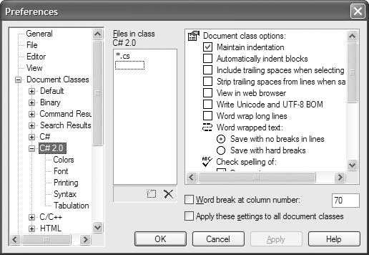
You can now TextPad’s C# support using the Document Classes node accessible from the
Configure ->Preferences menu.

Slide 132
Configuring the *.cs File Filter
The next configuration is to create a filter for C# source code files displayed by the Open and Save dialog boxes:
1. Activate the Configure -> Preferences menu option and select File Name Filters from the tree view control.
2. Click the New button, and enter C# into the Description field and *.cs into the Wild cards text box.
3. Move your new filter to the top of the list using the Move Up button and click OK.
Create a new file (using File -> New) and save it in a convenient location (such as C:\TextPadTestApp) as TextPadTest.cs. Next, enter a trivial class definition

Slide 133
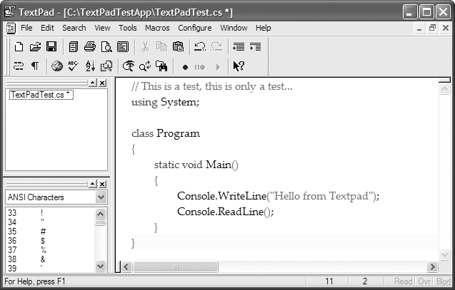

Slide 134
Hooking Into csc.exe
hooking is term it covers a range of techniques used to alter or augment the behavior of an operating system, or applications.
The last configuration to challenge with is to connect csc.exe with TextPad for compile your C# files.
The first way to do so is using the Tools -> Run menu option.
Dialog box appears that allows you to specify the name of the tool to run and any necessary command-line flags.

Slide 135
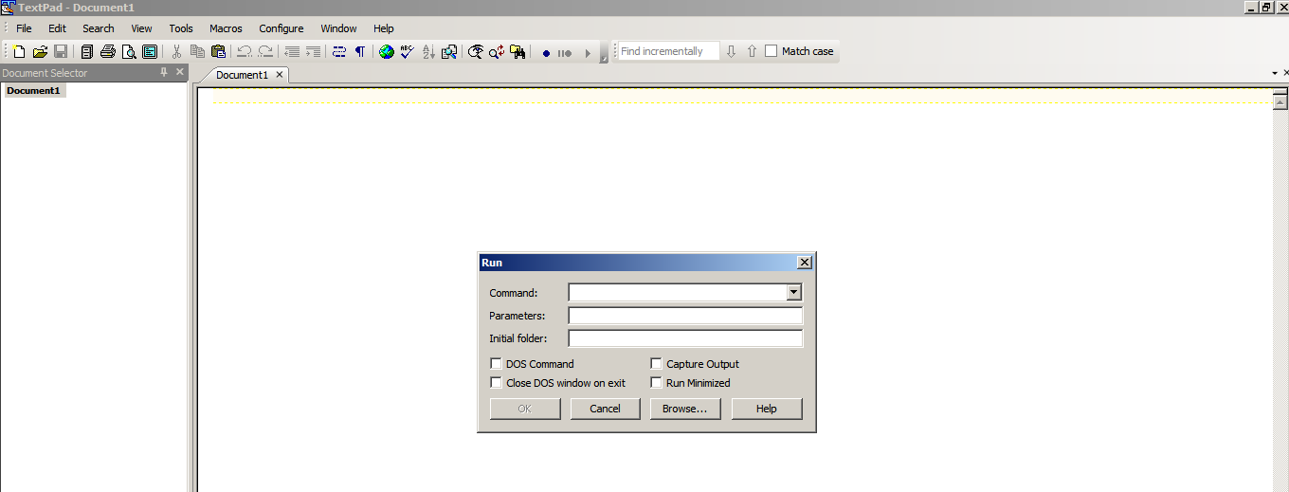

Slide 136
To compile TextPadTest.cs into a .NET console-based executable, follow these steps:
1. Enter the full path to csc.exe into the Command text box (e.g., C:\Windows\Microsoft.NET\Framework\v2.0. 50215\csc.exe).
2. Enter the command-line options you wish to specify within the Parameters text box
(e.g., /out:myApp.exe *.cs).

Slide 137
3. Enter the directory containing the input files via the Initial folder text box (C:\TextPadTestApp in this example).
4. If you wish TextPad to capture the compiler output directly (rather than within a separate
command window), select the Capture Output check box.

Slide 138
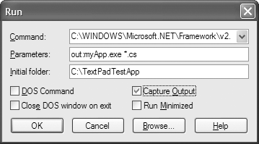

Slide 139
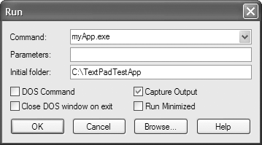
Run your program by double-clicking the executable using Windows Explorer or leverage the Tools ->Run menu option to specify myApp.exe as the current command

Slide 140
When you click OK, you should see the program’s output (“Hello from TextPad”) displayed in the Command Results document.

Slide 141
Associating Run Commands with Menu Items
TextPad also allows you to create custom menu items that represent predefined run commands.
create a custom item under the Tools menu named “Compile C# Console” that will compile all C# files in the current directory:
1. Activate the Configure ->Preferences menu option and select Tools from the tree view control.
2. Using the Add button, select Program and specify the full path to csc.exe.

Slide 142
3. rename csc.exe to a more descriptive label (Compile C#) by clicking the tool name and then clicking OK.
4. Finally, activate the Configure ->Preferences menu option once again, but this time select Compile C# from the Tools node, and specify *.cs as the sole value in the Parameters field

Slide 143
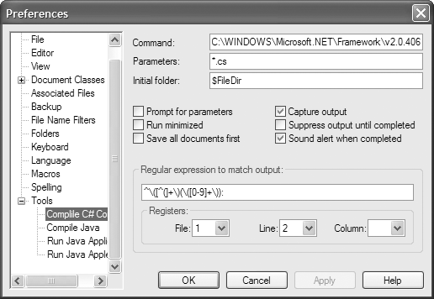
With this, you can now compile all C# files in the current directory using your custom Tools menu item.

Slide 144
Enabling C# Code Snippets
Before leaving at the back the world of TextPad, one final free add-on you might wish to install.
Navigate to http://www.textpad.com/add-ons/cliplibs.html and download csharp_1.zip using the
C# clip library provided by Sean Gephardt.
Extract the contained csharp.tcl file and place it in the
Samples subdirectory.
When you restart TextPad, you should find a new clip library named C Sharp Helpers available from the Clip Library drop-down list.
Double-clicking any item will insert the related C# code in the active document at the location of the cursor.

Slide 145
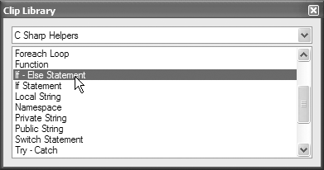

Slide 146
Building .NET Applications Using SharpDevelop
SharpDevelop is an open source IDE.
This IDE is completely free, it was written entirely in C#.
Download run a setup.exe program to install SharpDevelop on your development machine.
It can be obtained from:
http://www.icsharpcode.net/OpenSource/SD/Download

Slide 147
Once installation is complete,
File ->New ->Combine menu option.
It allows you to pick which type of project you wish to generate (and in which .NET language).
In the language of SharpDevelop, a combine is a collection of individual projects.

Slide 148
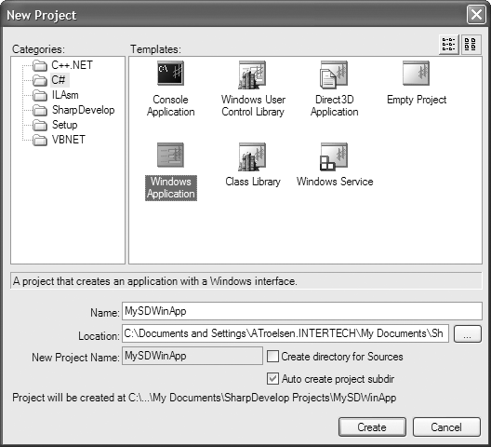

Slide 149
SharpDevelop
SharpDevelop provides some of the major benefits:
Support for the Microsoft and Mono C# compilers
code expansion capabilities
An Add Reference dialog box to reference external assemblies.
A visual Windows Forms designer
Various project perspective windows to view your projects
An integrated object browser utility.
Database manipulation utilities
A C# to VB .NET (and vice versa) code conversion utility
Integration with the NUnit (a .NET unit test utility) and NAnt (a .NET build utility)
Integration with the .NET Framework SDK documentation

Slide 150
The Project and Classes Scouts
Scouting or the Scout Movement is a movement that aims to support young people in their physical, mental and religious development.
When you create a new unite, you can make use of the Project Scout to view the set of files, referenced assemblies, and resource files of each project.

Slide 151
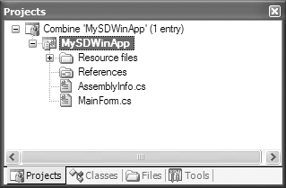

Slide 152
When you wish to reference an external assembly for your current project.
right-click the References icon within the Project Scout and select the Add Reference context menu.
Next, you may select assemblies directly from the GAC as well as custom assemblies via the .NET Assembly Browser tab.

Slide 153
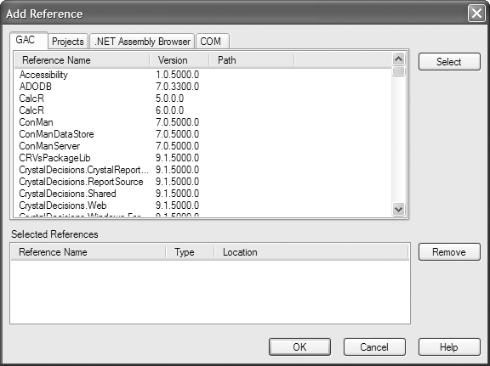

Slide 154
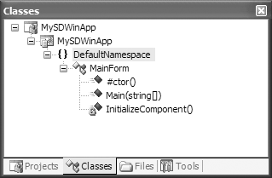
Classes Scout
The Classes Scout displays the namespaces, types, and members within each project

Slide 155
If you double-click any item, SharpDevelop responds by opening the corresponding file and placing your mouse cursor at the item’s definition.

Slide 156
The Assembly Scout
The Assembly Scout utility (accessible from the View menu) allows you to graphically browse the assemblies referenced within your project.
This tool is split into two window. On the left is a tree view control that allows you to drill into an assembly and view its namespaces and the contained types

Slide 157
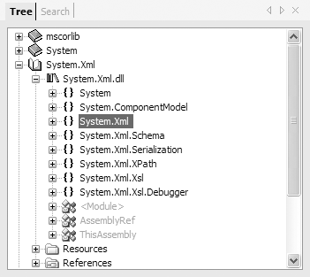

Slide 158
The right side of the Assembly Scout utility allows you to view details of the item selected on the left pane.

Slide 159
Windows Forms Designers
Windows Forms is a toolkit used to build desktop applications.
To continue tinkering with SharpDevelop, click the Design tab located at the bottom of the MainForm.cs code window.
Next, open the integrated Windows Forms designer.

Slide 160
Using the Windows Forms section of your Tools window you can create a GUI for the Form you are designing.
place a single Button type on your main Form by selecting the Button icon and clicking the designer.
To update the look and feel of any GUI item, you can make use of the Properties window.
activate from the View -> Properties menu selection.
Select the Button from the drop-down list and change various aspects of the Button type

Slide 161
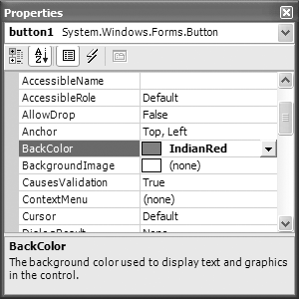

Slide 162
Once you press the Enter key, SharpDevelop responds by generating stub code for your new method.
void ButtonClicked(object sender, System.EventArgs e)
{
this.Text = "Stop clicking my button!";
}
run your program (using the Debug -> Run menu item).

Slide 163
Building .NET Applications Using Visual C# 2005 Express
In 2004, Microsoft introduced a brand-new line of IDEs that fall under the designation of “Express” products.
there are six members of the Express family:
Visual Web Developer 2005 Express.
Visual Basic 2005 Express.
Visual C# 2005 Express, Visual C++ 2005 Express, and Visual J# 2005 Express.
SQL Server 2005 Express

Slide 164
.NET Application using Visual Studio ( various versions)
It is an integrated development environment (IDE) from Microsoft.
It can be used to develop console and graphical user interface applications along with Windows Forms applications, web sites, web applications, and web services.

Slide 165
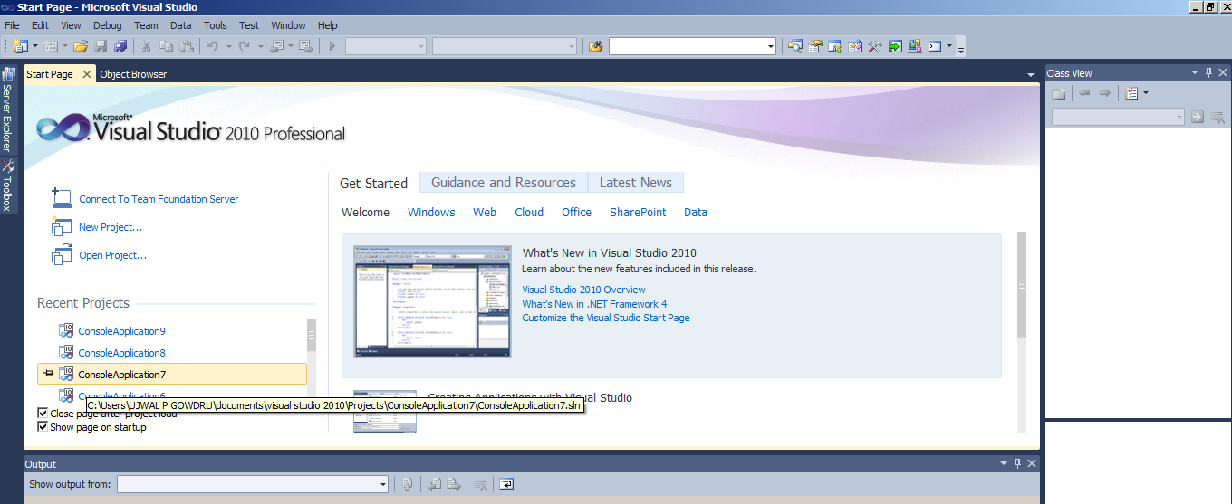

Slide 166
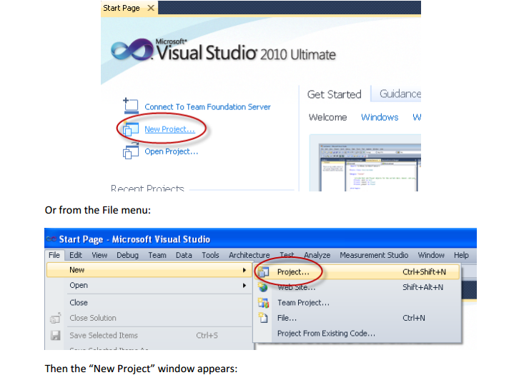

Slide 167
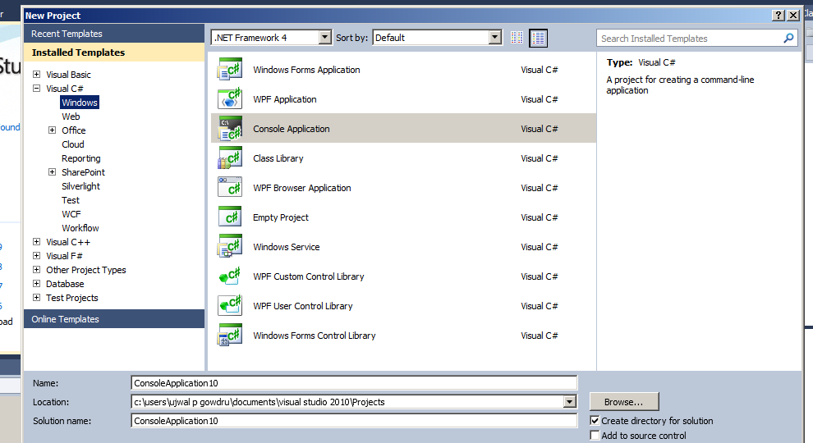

Slide 168
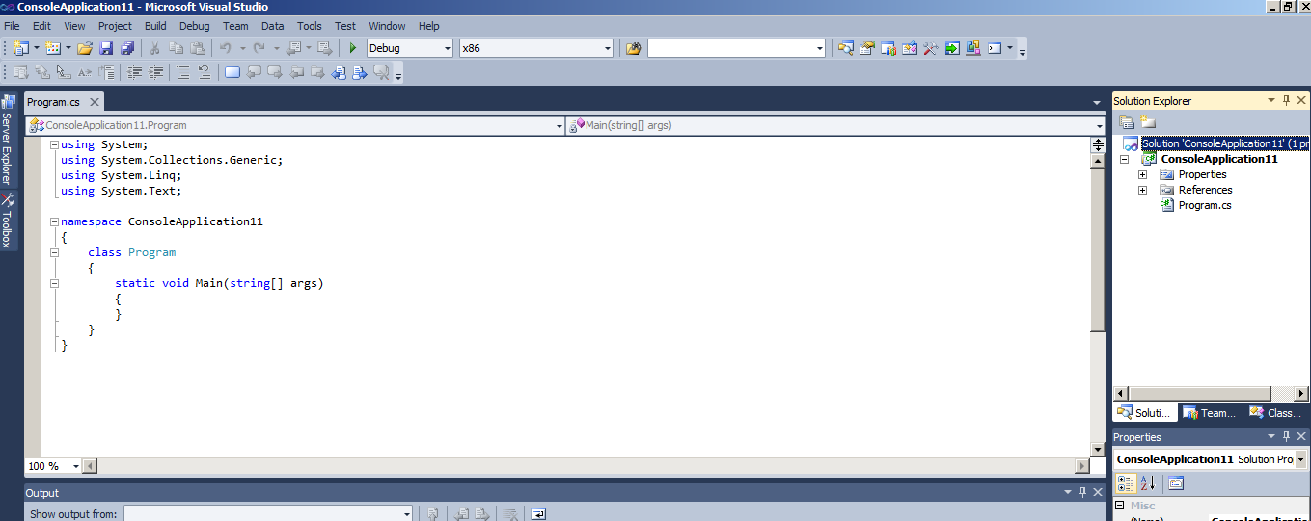

Slide 169
The most common applications are:
Windows Form Application
Console Application
WPF Application
ASP.NET Web Application
Silverlight Application

Slide 170
Solution Explorer
Solutions and projects contain items.
That represent the references, data connections, folders, and files that you need to create your application.
A solution container can contain multiple projects and a project container typically contains multiple items.

Slide 171
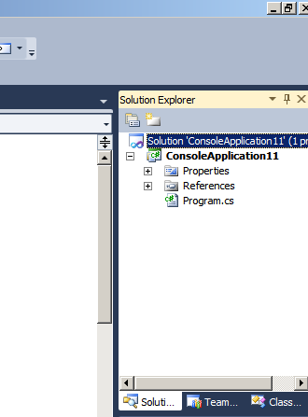

Slide 172

Properties window

Slide 173
Project properties window
view or modify properties associated with your projects in either the Properties window or the Project Property Pages dialog box.
To view project properties:
To view project properties
In Solution Explorer, select a project.
On the View menu, select Properties Window.
In the Properties window, modify the properties you want to change.

Slide 174


Slide 175


Class view utility
To show all of the types in your current project from an object oriented perspective.

Slide 176

The Code Definition Window

Slide 177
Code Refactoring
Refactoring is the process of improving your code after it has been written by changing the internal structure of the code without changing the external behavior of the code.
One major enhancement that ships with Visual Studio 2005 is intrinsic support to refactor existing code.
refactoring is a formal and mechanical process whereby you improve an existing code base.

Slide 178
Methods
There are 5 methods of applying effective refactoring over your code, these methods are already available in Visual studio:
Extract Method
Extract interface
Rename
Promote variable to the parameter
Encapsulate Field
Generate method stub

Slide 179


Slide 180
Extract Method
Extract method is the most simple and best way to refactor the code.
It breaks your code into several small blocks or methods.
You can apply this method in your code segment easily.

Slide 181


Slide 182
Select any block of code from your code segment.
after selecting this code segment you have two options, you can either use the Refactor option from the menu in Visual Studio or you simply right-click and select it.

Slide 183


Slide 184


Slide 185

After clicking on the Refactor option click on "Extract Method..."

Slide 186
On clicking, a pop-up window will appear.
Enter a NEW_METHOD name in the pop-up box window in the blank field.

Slide 187

On clicking, a pop-up window will appear

Slide 188

Now click on OK.

Slide 189

Then if there are any variables in you code segment then all those were automatically shown as variables in the method signature.

Slide 190
Once the name of the code is confirmed, the new method will be created automatically. Now, a call to the new method replaces the extracted code block.

Slide 191
Visual class designer
The Class Designer utility allows you to view and modify the relationships of the types (classes, interfaces, structures, enumerations, and delegates) in your project.
Using this tool, you are able to visually add (or remove) members to (or from) a type and have your modifications reflected in the corresponding C# file.

Slide 192
modify a given C# file, changes are reflected in
the class diagram.
To work with this aspect of Visual Studio 2005, the first step is to insert a new class diagram file.
There are many ways to do so, one of which is to click the View Class Diagram button located on Solution Explorer’s right side

Slide 193


Slide 194

Once you do, you will find class icons that represent the classes in your current project. If you click the arrow image, you can show or hide the type’s members

Slide 195
The Class Details window not only shows you the details of the currently selected item in the diagram.
But also allows you to modify existing members and insert new members on the fly.

Slide 196


Slide 197

Class Designer Toolbox
allows you to insert new types into your project (and create relationships between these types) visually.

Slide 198

Adding a field with the Class Details window

Slide 199
Working with csc.exe Response Files
Response files in C#:
write any .NET application it will always add some of the assemblies by default.
How will this happen?
Most of them think about the probable answer is GAC[Shared Assemblies].
But actual answer is completely different. The answer is a response file.

Slide 200
What is a response file (.rsp) file?
A response file is a text file.
It tells the compiler what are the command line switches to be added.
When you execute CSC.exe, the compiler opens response files and uses any switches that are specified in them as though the switches were passed to CSC.exe on the command line.

Slide 201
When you install the .NET Framework, it installs a default global CSC.rsp file.
%System-Root%\Microsoft.NET\Framework\vX.X.X
directory
(where X.X.X is the version of the .NETFramework you have installed).

Slide 202
This file contains command-line options that the c# command line compiler (CSC) will process as part of every compilation, unless the “/noconfig” option is specified.

Slide 203
C# compiler supports the use of response files C# response files contain all the instructions to be used during the compilation of your current build.
By convention, these files end in a *.rsp (response) extension.

Slide 204
Assume that you have created a response file named Test.rsp that contains the following arguments (comments are denoted with the #):
# This is the response file for the TestApp.exe of example
# External assembly references.
/r:System.Windows.Forms.dll
# output and files to compile (using wildcard syntax).
/target:exe /out:Test.exe *.cs

Slide 205
The 4.0 version of the file contains the following switches
# This file contains command-line options that the C# command line compiler (CSC) will process as part of every compilation, unless the "/noconfig" option # is specified.
/r:Accessibility.dll /r:Microsoft.CSharp.dll /r:System.Configuration.dll /r:System.Configuration.Install.dll /r:System.Core.dll /r:System.Data.dll /r:System.Data.DataSetExtensions.dll /r:System.Data.Linq.dll /r:System.Deployment.dll /r:System.Device.dll /r:System.DirectoryServices.dll

Slide 206
/r:System.dll /r:System.Drawing.dll /r:System.EnterpriseServices.dll /r:System.Management.dll /r:System.Messaging.dll /r:System.Numerics.dll /r:System.Runtime.Remoting.dll /r:System.Runtime.Serialization.dll /r:System.Runtime.Serialization.Formatters.Soap.dll /r:System.Security.dll /r:System.ServiceModel.dll /r:System.ServiceProcess.dll /r:System.Transactions.dll /r:System.Web.Services.dll /r:System.Windows.Forms.Dll /r:System.Xml.dll /r:System.Xml.Linq.dll

Slide 207
Assuming this file is saved in the same directory as the C# source code files to be compiled.
you are able to build your entire application use(note the use of the @ symbol):
csc @Test.rsp
Also able to specify multiple *.rsp files as input ( csc@ firstFile.rsp @secondFile).

Slide 208


